Slide 1
HyFlex Learning Community Webinar
Supporting HyFlex Learners

Slide 2

Welcome!
Webinar Goals:
Discuss supporting students in understanding and making effective choices among available participation modes
Create a shareable resource we can all use (and modify) for our own students
Ideas, questions, and suggestions!
https://www.hyflexlearning.org/
Notes:
Welcome! To those who may be new to this group, the HyFlex Learning Community is a community of educators working together to improve student access to high quality and equitable learning by using Hybid-Flexible (HyFlex) learning environments. HyFlex learning experiences are available in the classroom or online, and support students choosing which participation mode is best for them. This is the 2nd webinar hosted by this community as in and today we are focused on supporting students in understanding and making effective choices among available participation modes. We would like your input as we create a shareable resource we can all use and modify for our own students and hope that you have ideas, questions and suggestions! Since you are here, you have likely visited our website, hyflexlearning.org. But if you haven’t yet, please do visit and join the group.

Slide 3
Poll: Role
What is your current or future role related to supporting HyFlex learners?
Faculty
Administration
Support Staff (ID, IT, ITS)
Student
Poll link: https://www.menti.com/mne4xjpqmy
Notes:
We would like to start with a poll to see who are audience is. What is your current, or future, role related to supporting HyFlex learners? DISCUSS Results

Slide 4

Poll: Current Support
What does your institution currently do to help students choose their HyFlex participation mode and prepare them for HyFlex classes?
Poll link: https://www.menti.com/mne4xjpqmy
Notes:
Open ended responses
Next, please type a response to this question: What does your institution currently do, or plan to do, to help students choose their HyFlex participation mode and prepare them for HyFlex classes? DISCUSS

Slide 5
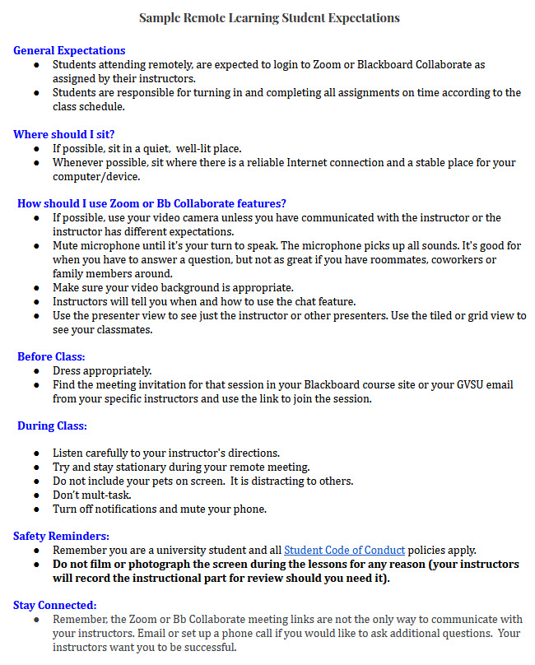
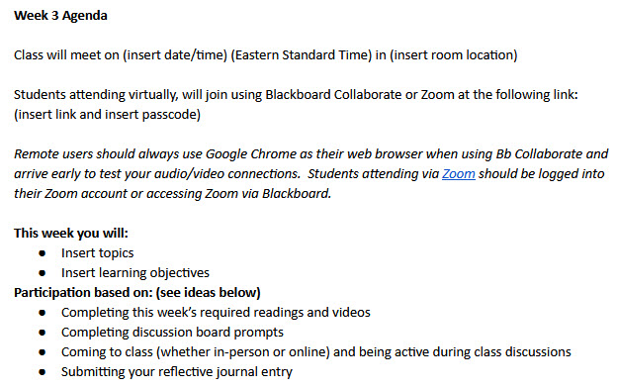
Sample Student Support Documents
Remote Student
Learning Expectations
Grand Valley State University. (2021, April). Tips for Teaching HyFlex and Staggered Hybrid Courses with Remote Learners. Retrieved from https://www.gvsu.edu/elearn/help/tips-for-teaching-hyflex-and-staggered-hybrid-courses-137.htm
Notes:
Lots of information published around supporting faculty to support students. It can be harder to find student support documentation. Here are two examples from Grand Valley State University.

Slide 6
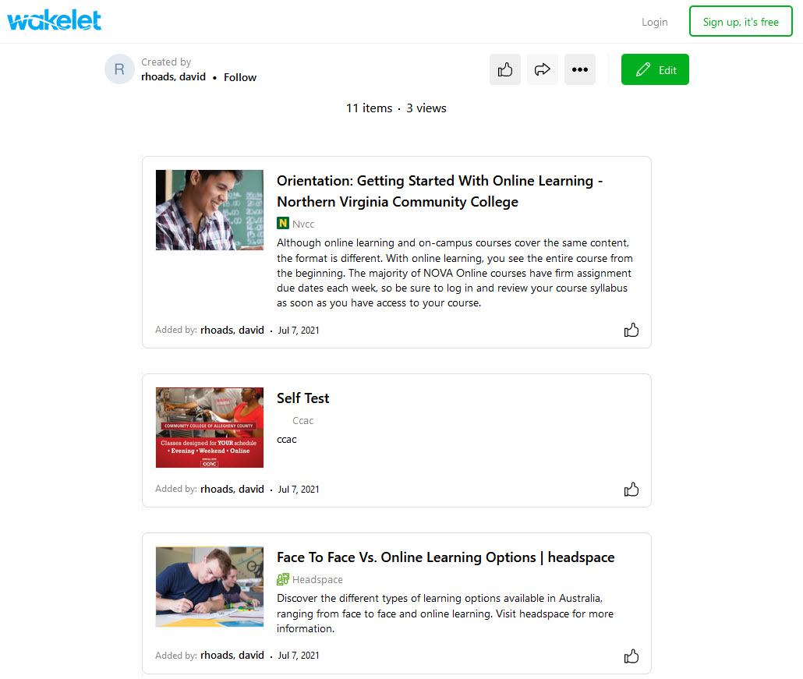
Wakelet Collection
Remote Student
Learning Expectations
https://wakelet.com/i/invite?code=c22f970

Slide 7
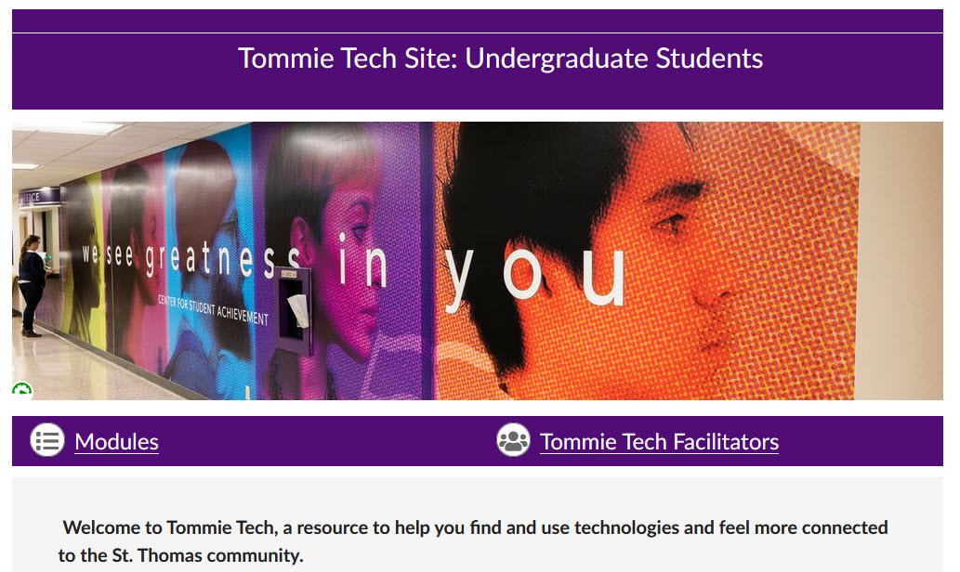
General Academic Technology Support
Tommie Tech invites students to:
learn about key tech systems such as Canvas, Zoom, Murphy, Office 365, and OneStThomas;
set up their devices including free apps to download;
practice with technology tools; and
locate additional resources while learning online.
Tommie Tech includes videos, tutorials, and optional activities so that students start their classes knowing how to upload assignments, set their notifications, find 24/7 help, and more. Tommie Tech Site Facilitators are available (daily) to participate in discussion and respond to questions.
Notes:
Resources such as these help support the accessibility principle of HyFlex learning. Providing students with the support they need to participate in the delivery model they choose and not be limited by technology issues.

Slide 8

The Student Perspective
“What do I need to help me be a successful HyFlex learner?”
Notes:
Ashley

Slide 9
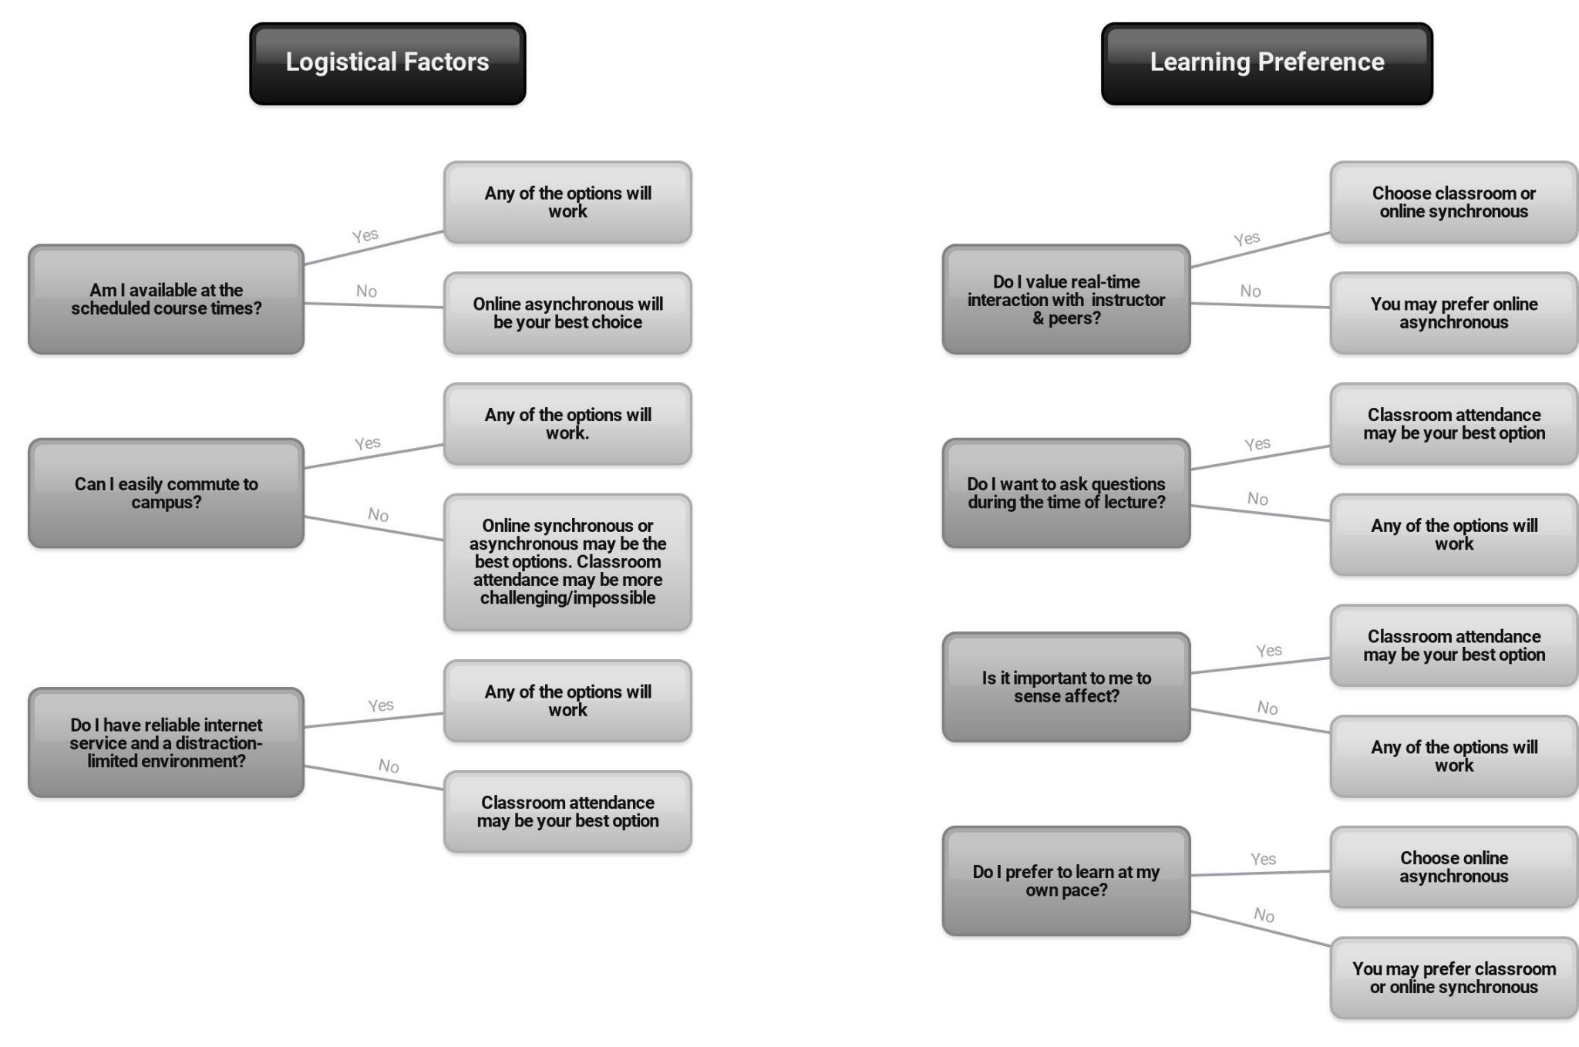
Decision
Tree
Notes:
https://drive.google.com/file/d/1l-D-hKNWYBje3XadnsjmrsgbY0Z28Fo3/view?usp=sharing
Share in chat

Slide 10
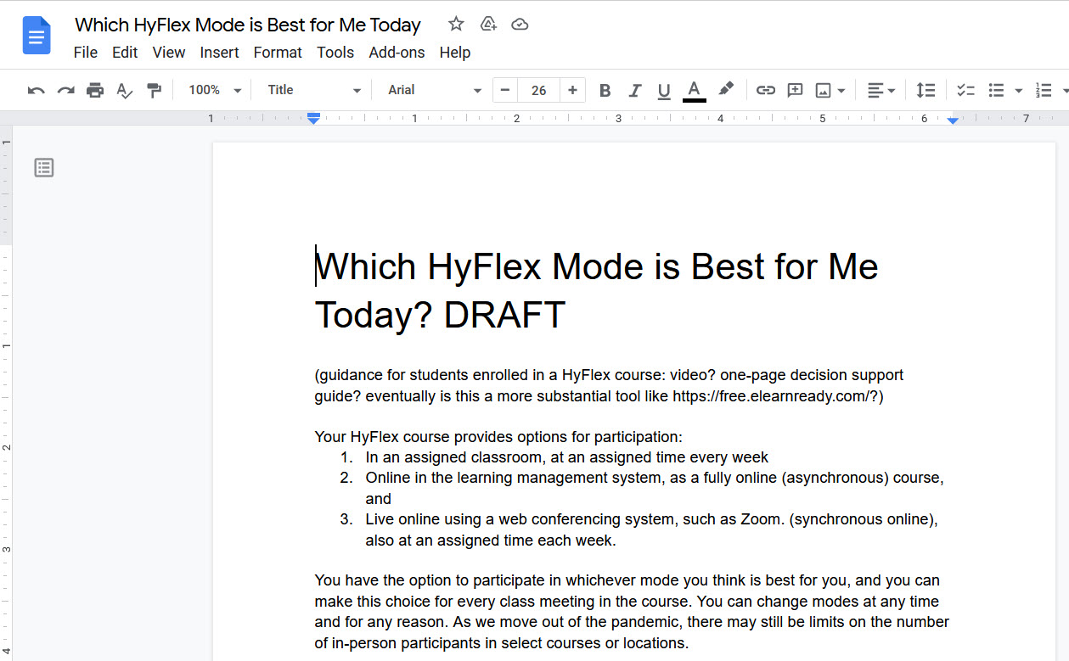
Collaborative Support Document
Review (5 minutes)
Discuss and brainstorm ways we can support students as they make choices about how they'll participate in their HyFlex course.
  What guidance is needed?
  What are students likely to use?
  How can the HyFlex Learning Community support site support faculty and designers in developing support resources?
Notes:
Paste link in chat
https://docs.google.com/document/d/1OfYCKcoqXPTbQ11ed6MTSitNlro8ccJt6TIJMapVjI0/edit?usp=sharing

Slide 11


